Slide 1
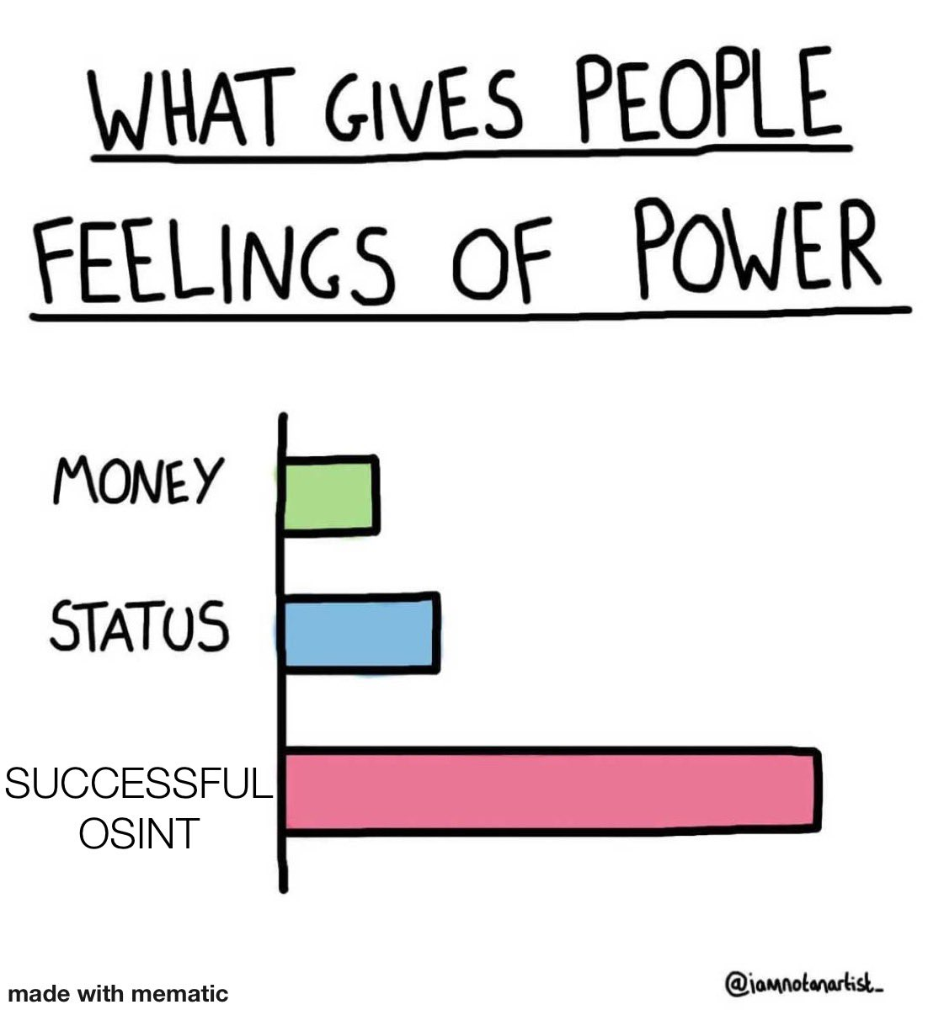
OSINT Side-Channels
How I know what you drive, where you sleep, and what you eat
Ben Eldritch

Slide 2
Disclaimer!
This is not a step-by-step guide to cyberstalking
Be respectful to others and their privacy
Always ensure you have proper consent before attempting these tactics on others
Recommend you perform a few of these checks on yourself and locate your own footprints
Not everything talked or shown will be 100% useful and accurate all the time, always take information with a grain of salt when on the internet

Slide 3
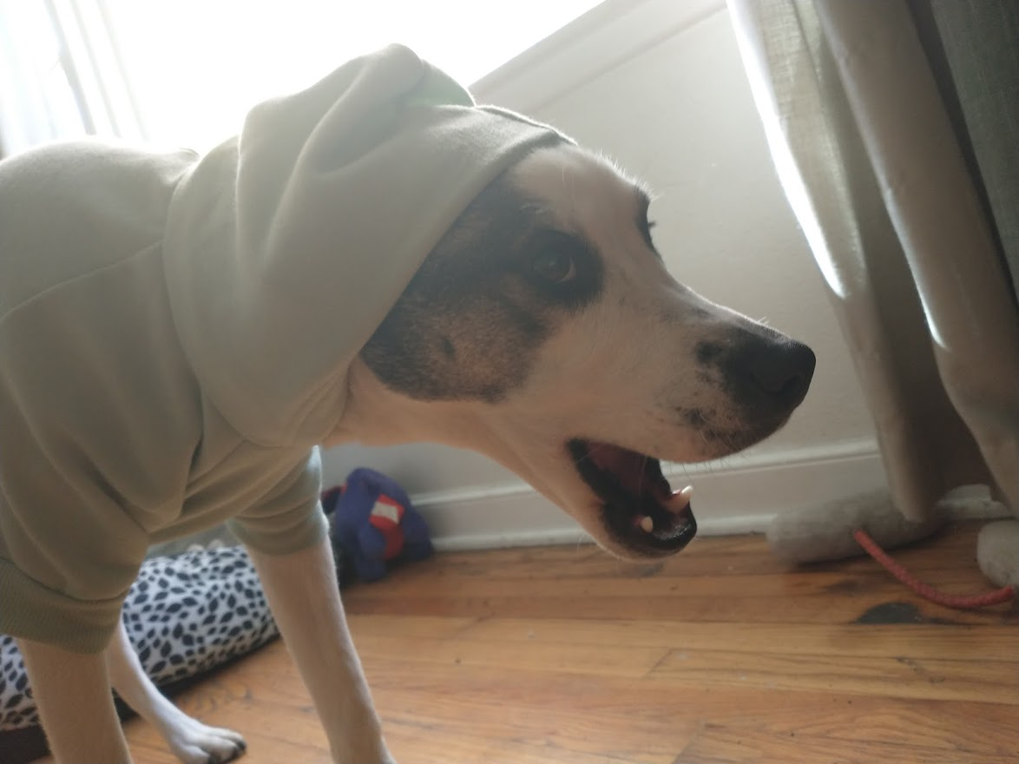
Whoami /all
About Me:
New to Virginia, have lived in a lotta places!
Currently work at Raytheon Technologies
Nature lover
Bushcrafter by day, hacker by night
Stuff I’ve done:
OSCP, Pentest+, CySA+, Sec+, Network+, etc…
Iowa State Cyber Defense Competitions
NCL, Sans, Google CTFs
NSA Codebreaker Challenges
Webapp pentesting
Kontrabear, BenTheCyberOne
Thissiteissafe.com
3

Slide 4
Information
=
Power?
What is OSINT?

Slide 5
What’s OSINT?
The gathering and analysis of information about someone or something via publicly accessible data
Information is typically categorized and filtered into “finished intelligence”
Non-contextual “raw” data -> data is processed and filtered -> synthesized, useful information
Target publicly tweets about food
Filter through tweets, catalog where tweet contains “favorite”, “love”, etc.
They “love” spaghetti!
5

Slide 6
What’s OSINT?
Knowledge is power!!!
Information – especially on the internet – lasts forever
NOT limited to just the cyber-realm
Information is open-source if it is:
Published or broadcast for a public audience
Available to the public by request
Available to the public by subscription or purchase
Could be seen or heard by any casual observer
Made available at a meeting open to the public
Obtained by visiting any place or attending any event that is open to the public
6

Slide 7
How is this useful to me?
The Ice Cream Dilemma
7

Slide 8
The Ice Cream Dilemma
It’s Summer! Time to go out for ice cream!
Sweet Treat Ice Cream Co. is packed, but the employees are working hard as always!
The scooper, who wears a nametag labeled “Josh”, hands you the best ice cream bowl you’ve ever had
Before you have a chance to tip him, you rush out to avoid angering the long line of customers
8

Slide 9
The Ice Cream Dilemma
I want to tip Josh for his hard work, but don’t want to wait in line again.
I won’t be at this location again for a while. How can I contact Josh?
9

Slide 10
The Ice Cream Dilemma
Google the location/business. What information do they have on their website? Social media accounts?
They have a LinkedIn! Looks like Josh is listed as an employee!
Time to query Josh’s full name!
Looks like Josh has a Twitter account with the handle @SweetTreatJosh
Josh had a Venmo link in his Twitter bio! We can finally tip him!
10

Slide 11
But wait! There’s more!
The Ice Cream Dilemma
(but I am a threat actor)
11

Slide 12
The Ice Cream Dilemma
(But I am a threat actor)
We now know Josh’s full name
We now know one of Josh’s handles (@SweetTreatJosh)
We can view Josh’s Venmo transactions for possible data
Josh has his resume on LinkedIn set to public, with a nifty phone number and email address!
Email domain of @sweetcreamco.com
Huh, josh.lastname@sweetcreamco.com
Josh has possibly used his company email for personal uses, seen through haveibeenpwned.com
Josh likes to post about his outings with the IT crew of Sweet Cream Ice Cream Co. on Instagram (using the same handle, of course)
Who wants to go phishing?

Slide 13
Basic OSINT Gathering Methods
Google! Bing! Yahoo!
Don’t limit yourself!
Dorking is efficient if you know the range of data you want
Social media is your friend*
LinkedIn
Twitter
Facebook
Instagram
Snapchat
Discord
Reddit
Dating Apps
Github!?
Look behind the curtains for metadata
* As long as you don’t use it

Slide 14
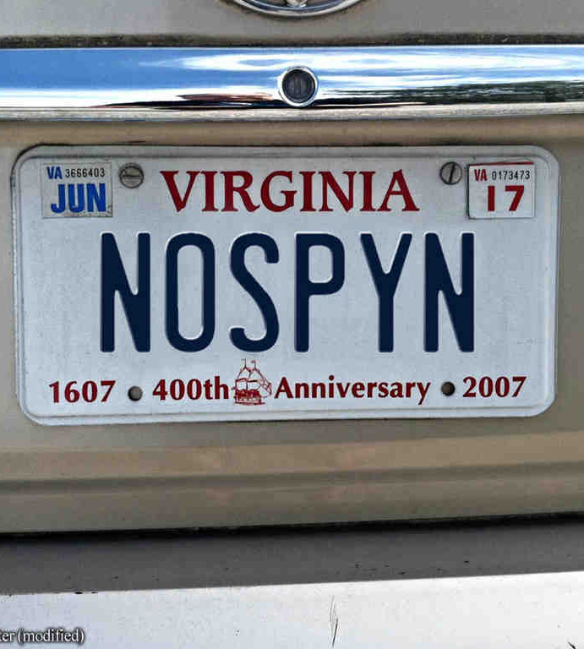
The Side-Channels

Slide 15
15

Slide 16
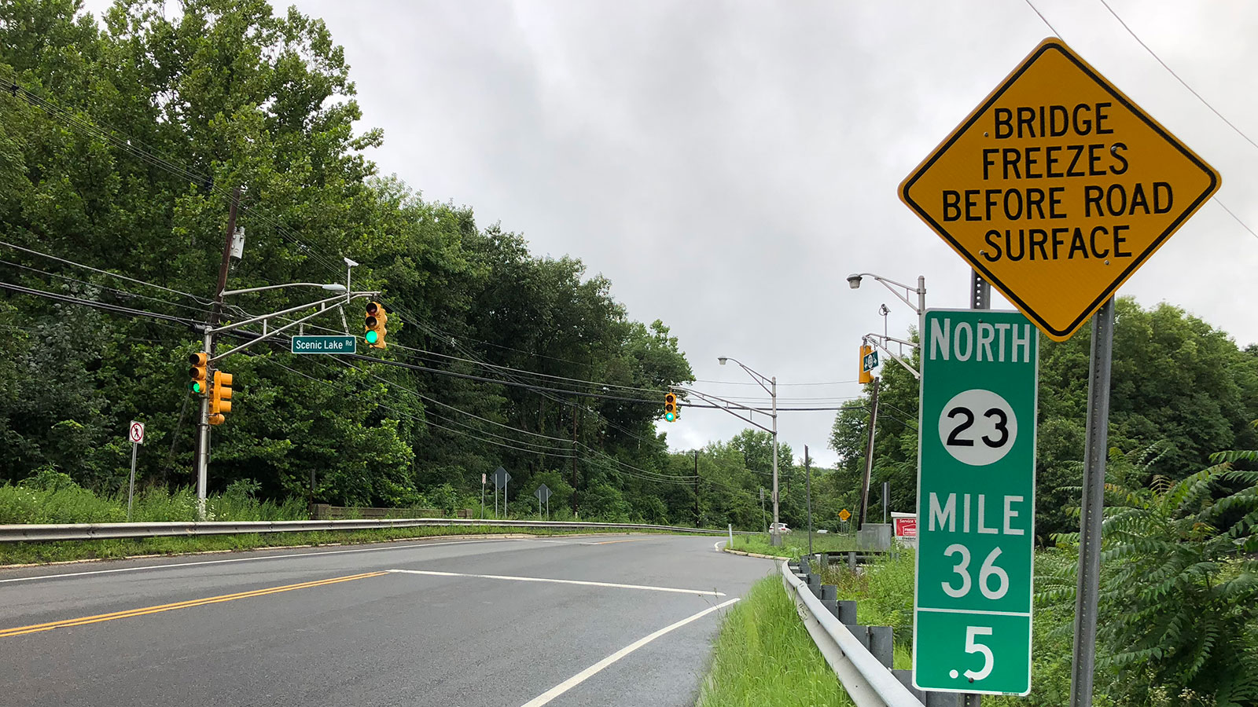
Look at This Photograph…
(Every Time I Do It Makes Me Laugh)
What’s in focus?
Who or what is the subject of the photo
Any accidental reflections of the surroundings?
Selfie? Group selfie? Class photo?
What’s OUT of focus?
What does the environment look like?
Any detailed signs or “Geoguesser” material?
Can we search for a specific object in the photo?
16

Slide 17
Security cameras
Reflections show cloudy day
Notable signs
Floor map!
Statue name
17

Slide 18
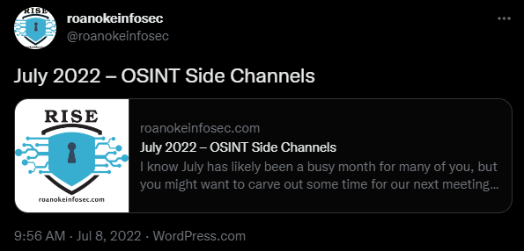
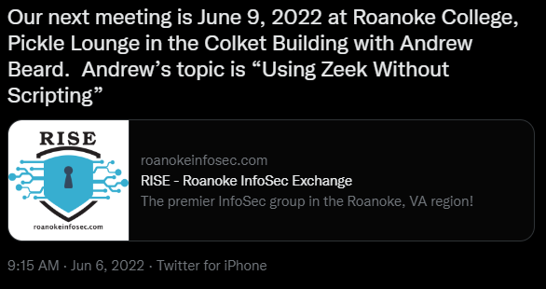
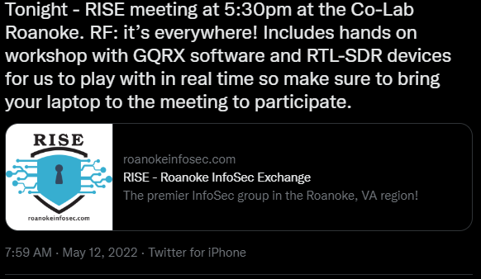
More Than Just Words…
What exact time was the post created?
Is there a frequency to when each post is created?
Late at night? Early in the day? Every other hour?
Who likes or reacts to the posts? Same people each time?
Language structure can help identify sock puppets!
18

Slide 19
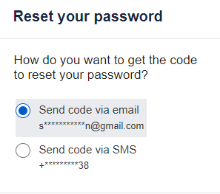
A Few Nifty Media Tricks
Have a phone number? Add it to your contacts and look at Snapchat for their handle!
Need a phone number and have their full name? Google them! (Whitepages)
Need any data in general? Use password reset functions!
Facebook allows users who signed up with a username (along with a few older userIDs) to login with them. No email address necessary!
It’s a pain, but piece by piece data can be connected (or guessed/bruteforced)
19

Slide 20
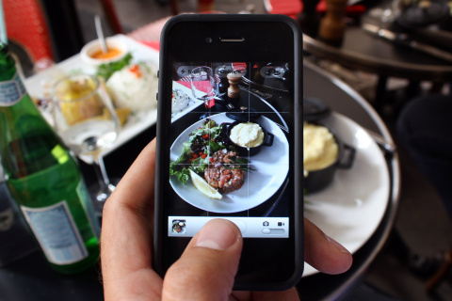
That Looks Delicious!
Foodstagrams can be analyzed just like any other post/picture
Frequency or pattern to when they are posted?
Anything in the photo we can use to determine where the food was bought/eaten?
Have a hefty collection of food images?
What are they usually eating in them?
What are they not eating?
Allergies? Don’t like spicy food?
20

Slide 21
“Joke’s on you Ben! I don’t post my food or bar drinks!”
But your friends might.
21

Slide 22
BFF Movement
Close connections provide great lateral movement!
Friends might not private or hide photos you are tagged in! (Facebook)
Friends might leak handles or even current location! (Snapchat)
But who’s friends with who?
Most “recommended friends” algorithms will reveal more than you think
Great way to get handles
22

Slide 23
Hey Dude, Nice Car!
Proud of that new wax finish? Show off your ride!
Better yet, get a front body picture of it and save it as your profile picture!
23

Slide 24
Hey Dude, Nice Car!
Blurring a plate is a little more important than you think…
With a license plate, we can view its history thanks to the National Motor Vehicle Title Information System! (NMVTIS)
But don’t you need a VIN for most sites?
Sometimes, but there are resources which provide the VIN by just providing the license plate!
Many sites will pressure you to purchase or subscribe for the report/information, skip them and continue searching
Or not, but please use volatile payment methods if you buy!
24

Slide 25
The Good!
Buying a used car and want to make sure it is legit? Check the history!
Check the exact year, make, and model of a car if you don’t know what car is what!
25

Slide 26
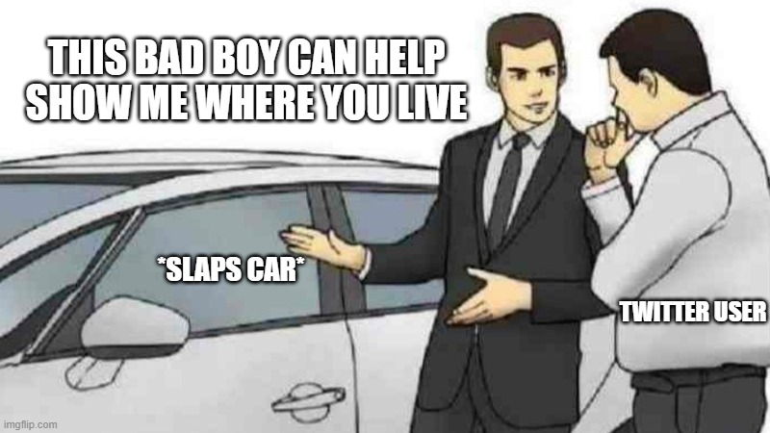
The Bad!
Obtain exact dates on when the title was changed (including the state!)
See when the owner took it to a dealership/service center last! (and possibly what city/county!)
Obtain the approximate milage of the vehicle
Obtain any possible accident record dates!
Phishing anyone?
26

Slide 27
A Few Nifty Resources
https://www.clearvin.com/en/
https://vincheck.info/
https://www.autocheck.com/
https://findbyplate.com/
https://www.vehiclehistory.com/
27

Slide 28
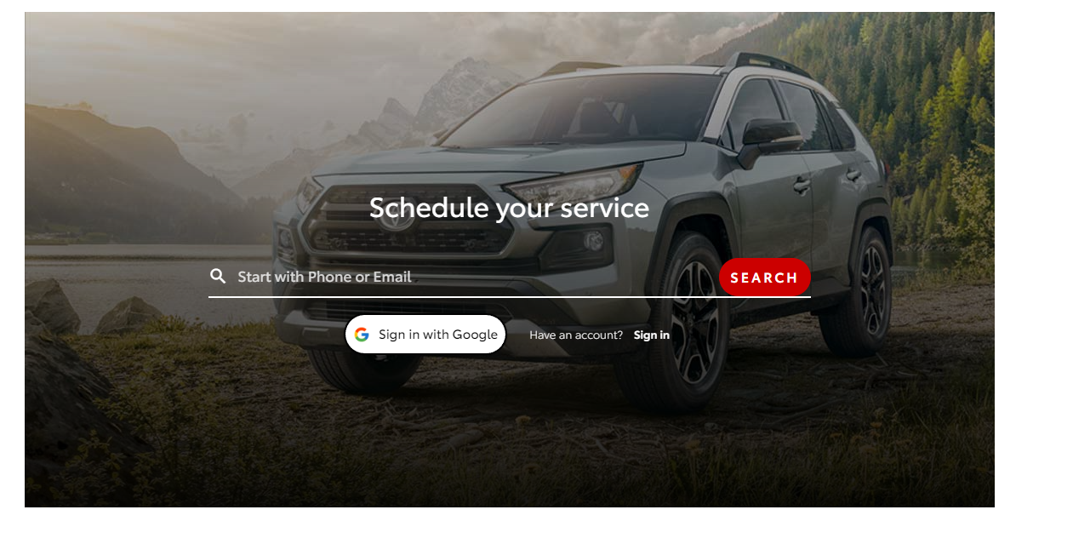
A Nifty Car Trick
Have a lot of information, such as a phone number or email but want to know their car?
Try booking service center appointments!
Many of the major dealership service centers use xtime to catalog user data…
28

Slide 29
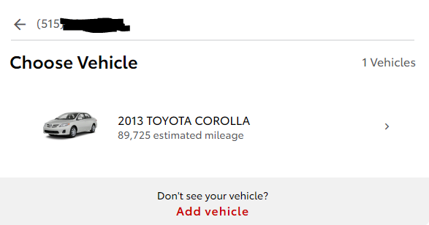
A Nifty Car Trick
Location specific, but you could theoretically play around with the URL…
https://consumer.xtime.com/scheduling/?&webkey=XTM202103011013XX1&bx=460288#/
Notice the webkey parameter?
There might be a few ways to bot that…
29

Slide 30
What A Lovely Home!
If there’s enough data to find their car, there’s enough data to find their address…
Previously mentioned methods can be chained to give approximate location
Some people, especially some business owners, will straight up share their address on their Instagram, personal websites/blogs, etc!
For easier transactions, addresses are sometimes seen on marketplaces such as Facebook’s!

Slide 31
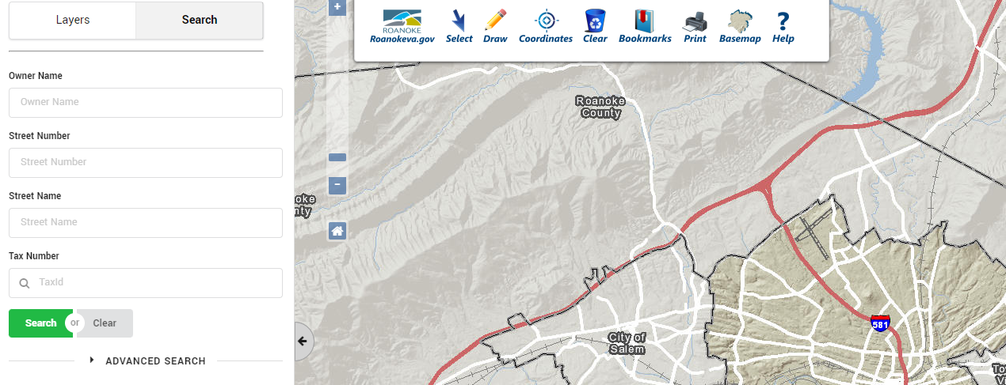
Sometimes, it’s easier than you think!

Slide 32
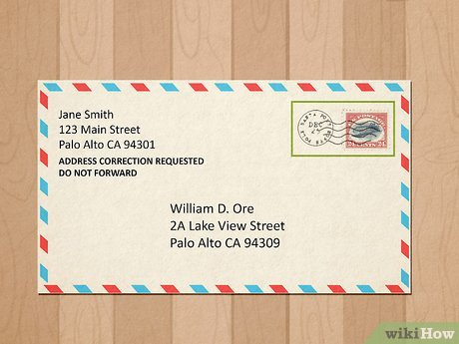
What a Lovely Home!
County, city assessor sites share public data on real estate/tax assessed locations
Some even allow you to search with just the name!
Can use in conjunction with real estate listing sites to gather some juicy info!
Know a previous address?
Address an envelope to the person’s previous address (make sure to include your own return address!)
Include “ADDRESS CORRECTION REQUESTED DO NOT FORWARD”
???
Profit!
Nextdoor app – welcome to the neighborhood!

Slide 33
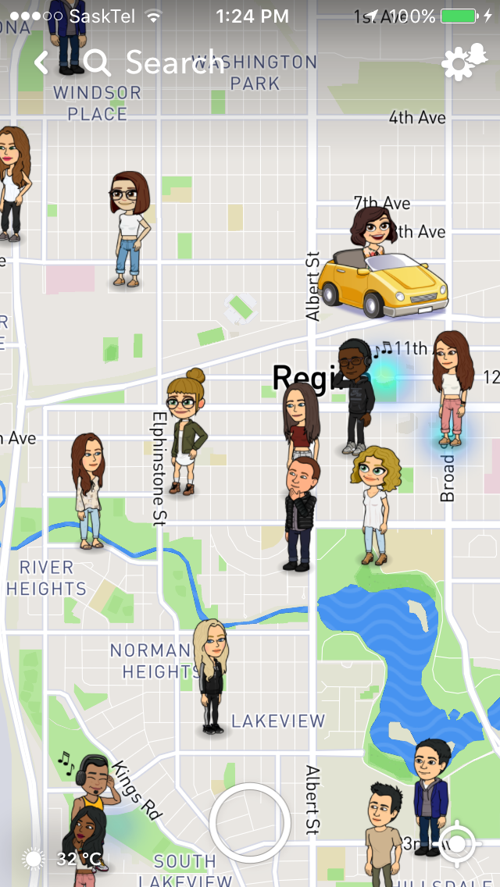
Sometimes, it’s much easier than you think!

Slide 34
Don’t forget about BFF Movement!
Snapmap!
Posts/photos during parties, cook outs, etc.
Don’t forget about possible relatives!
34

Slide 35
Protecting Yourself
Your data is everywhere all the time, there is nothing you can do (realistically)
Know what you are putting out there, how it could harm you, and how you could gather intel about yourself
Want to be precautious? Throw in some fake info from time to time (and log it, so you know when something leaks)
Sockpuppets!

Slide 36
Thank you!
Ben Eldritch
www.thissiteissafe.com
@TarantulasByte

